Slide 1
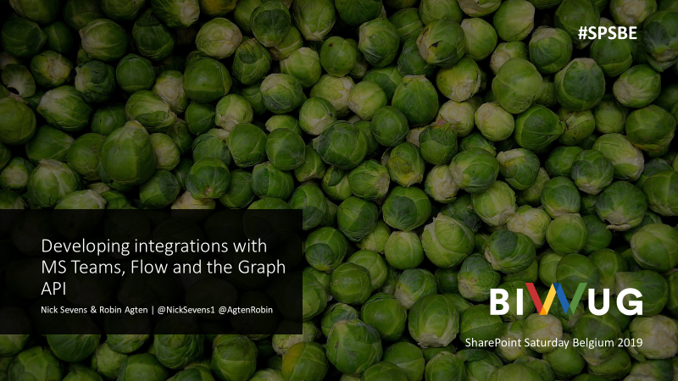

Slide 2
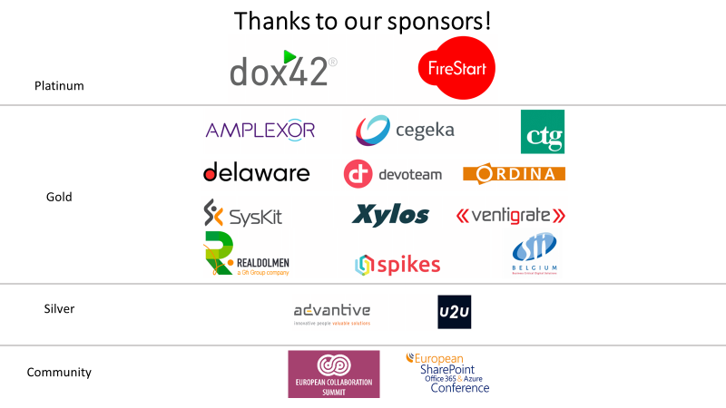

Slide 3
AGENDA
I
KEY CONCEPTS
II
DEMO
III
SHOWING THE CODE
IV
WRAP UP

Slide 4





BUSINESS SCENARIO
MS TEAMS AUTO ARCHIVING WORKFLOW
Graph API

Slide 5








KEY CONCEPTS MS TEAMS
A GLOBAL DEVELOPMENT PLATFORM
A chat-based workspace in O365 that integrates with the apps and services that people use to get work done together. The developer platform makes it easy to integrate your own services with Teams, whether you develop custom apps for your enterprise or SaaS applications for teams around the world.
TABS
APPS
BOTS
TASK MODULES
NOTIFICATIONS
CONNECTORS
ADAPTIVE CARDS
MESSAGING EXTENSIONS

Slide 6
KEY CONCEPTS MS TEAMS
KEY CONCEPTS MS TEAMS
A GLOBAL DEVELOPMENT PLATFORM
A chat-based workspace in O365 that integrates with the apps and services that people use to get work done together. The developer platform makes it easy to integrate your own services with Teams, whether you develop custom apps for your enterprise or SaaS applications for teams around the world.
A GLOBAL DEVELOPMENT PLATFORM
A chat-based workspace in O365 that integrates with the apps and services that people use to get work done together. The developer platform makes it easy to integrate your own services with Teams, whether you develop custom apps for your enterprise or SaaS applications for teams around the world.
TABS
APPS
BOTS
TASK MODULES
NOTIFICATIONS
CONNECTORS
ADAPTIVE CARDS
MESSAGING EXTENSIONS
6

Slide 7
KEY CONCEPTS SHAREPOINT FRAMEWORK (SPFx)
SHAREPOINT FRAMEWORK
The SharePoint Framework (SPFx) is a page and web part model that provides full support for client-side SharePoint development, easy integration with SharePoint data, and support for open source tooling.
Client-side development framework
No longer SharePoint only!
Custom Form in MS Teams tab
MSGraphClient
https://aka.ms/spfx

Slide 8
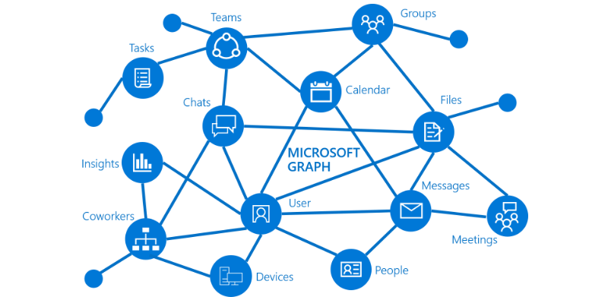
KEY CONCEPTS MS GRAPH API
A UNIFIED PROGRAMMABILTY MODEL
You can use to Microsoft Graph to build apps for organizations and consumers that interact with the data of millions of users and to access data in Azure Active Directory, Office 365 services, and more.
https://aka.ms/graph

Slide 9
KEY CONCEPTS MS GRAPH API
A UNIFIED PROGRAMMABILTY MODEL
You can use to Microsoft Graph to build apps for organizations and consumers that interact with the data of millions of users and to access data in Azure Active Directory, Office 365 services, and more.
Schema extensions
Add custom data to Graph Objects
Allows for searching and filtering directly from Graph API
https://aka.ms/schemaextensions

Slide 10
KEY CONCEPTS MS FLOW
Microsoft Flow is cloud-based software that allows employees to create and automate workflows and tasks across multiple applications and services without help from developers.
Scheduled task
No/Low code
Easy integration with O365 apps/apis
Adaptive Cards
https://adaptivecards.io/designer

Slide 11

DEMO

Slide 12
CONCLUSION
“Very easy with minimal code effort to extend MS Teams functionality using O365 ecosystem”

Slide 13



Q&A
Nick Sevens
Nick.Sevens@delaware.pro
Twitter: @NickSevens1
Robin Agten
Robin.Agten@delaware.pro
Twitter: @AgtenRobin

Slide 14



http://spsbe.be
#SPSBE
Please rate this session!

Slide 15

#SPSBE
SharePoint Saturday Belgium 2019

